Slide 1
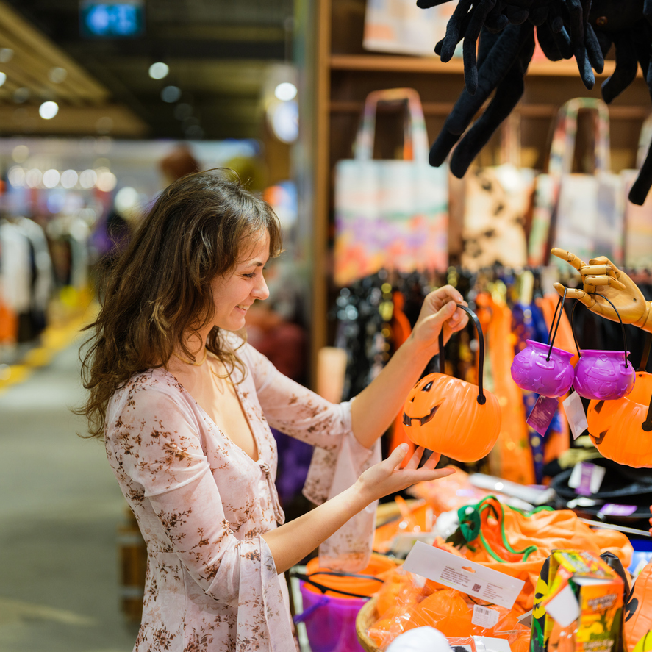

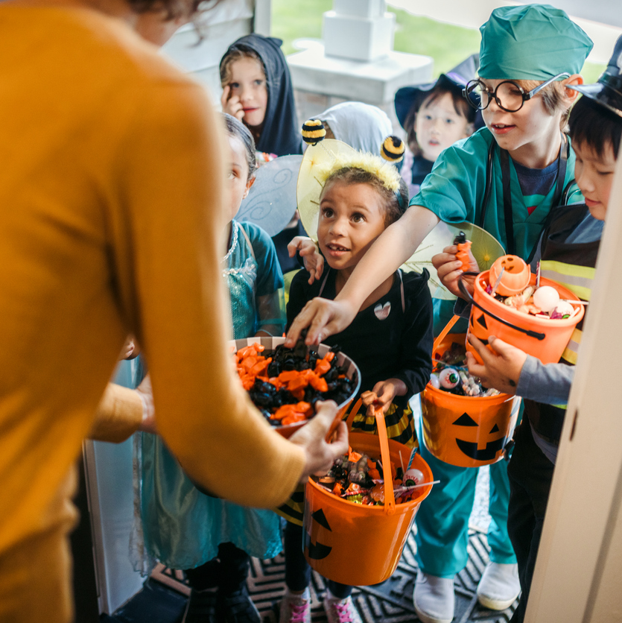

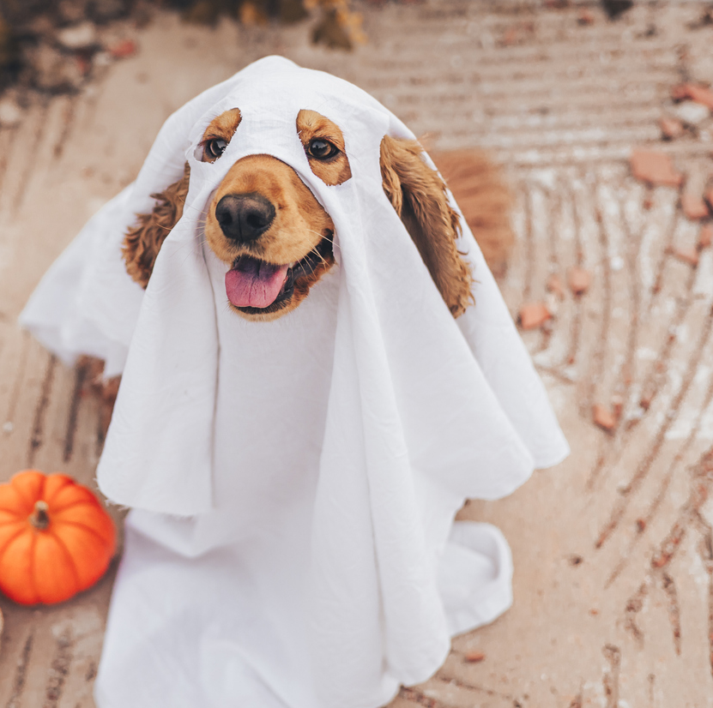

The 2026 Ghouls’ Guide to Growth: Winning the $13.1B Spooky Season
Fall 2026

Slide 2

The Multi-Billion Dollar Scare
Hyperlocal & Omnichannel Tactics for a Record-Breaking Season
This Halloween spending has surged to a record $13.1B, up nearly 13% from last year, with 49% of shoppers starting their journey in September or earlier. To win in 2026, brands must move beyond a single-channel approach. This playbook unmasks how to combine hyperlocal precision with omnichannel scale to reach the right people at the right time.
By activating through the channels most impactful for your brand, from high-impact CTV to real-time Mobile proximity, you can capture high-intent shoppers throughout their entire buyer journey.
Let’s unmask your 2026 growth.
Source: NRF

Slide 3
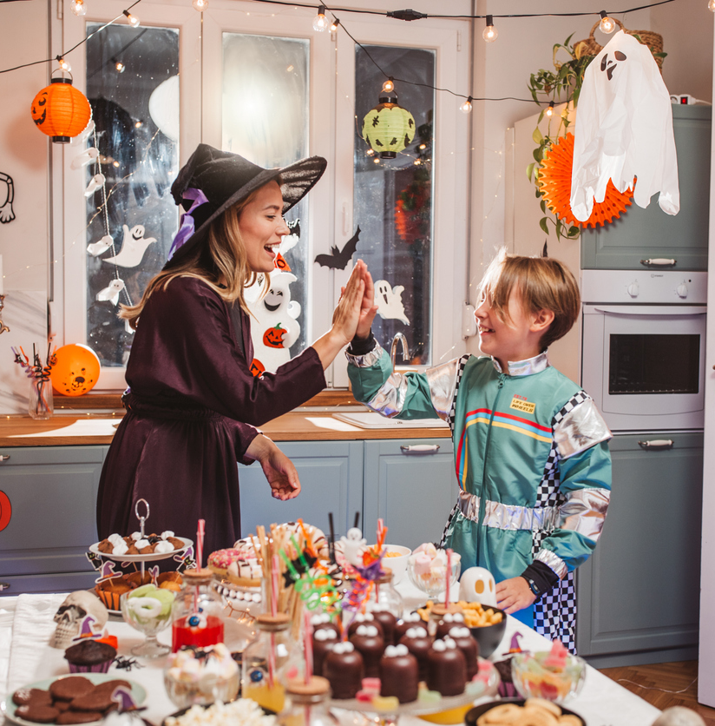
At a Glance
A high-level overview at 2025 Halloween trends and consumer spending patterns.
73%
Of consumers plan to celebrate Halloween in 2025.
$114
Average planned spend per person, nearly $11 higher than last year.
71%
Of consumers plan to buy costumes, spending an estimated $4.3B in total.
Source: NRF

Slide 4
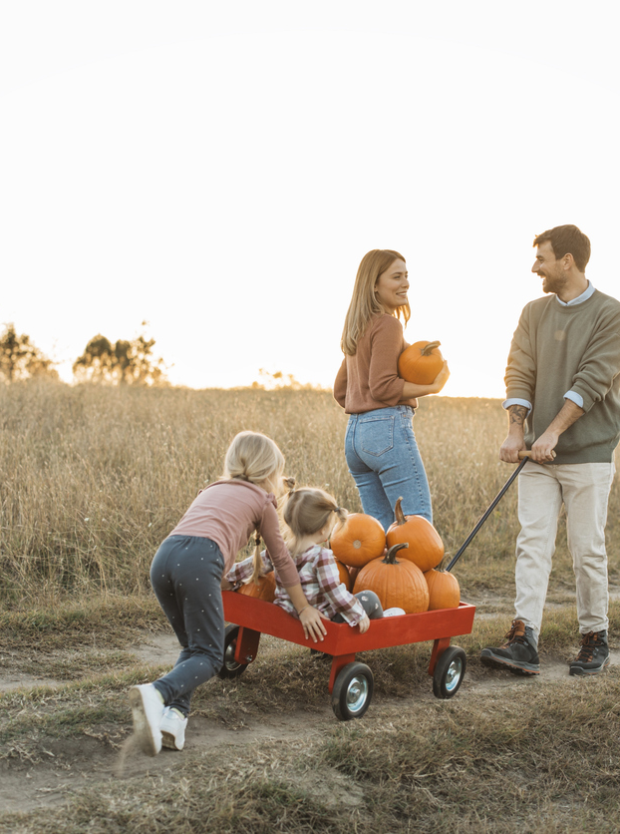




Top Activities and Spending Trends
Total expected spend on costumes and decorations led the way in 2025, totaling $8.5B, followed by $3.9B on candy.
However, record spending hasn't erased price sensitivity. With 79% of shoppers anticipating tariff-driven price hikes, 70% are utilizing cost-saving measures like shopping early or visiting discount stores to protect their "festive frights" budget.
From stocking up on candy to visiting haunted houses, everyone celebrates differently. The top ways consumers are celebrating the spooky holiday include:
66%
51%
51%
46%
31%
Handing out candy
Dressing up in a costume
Decorating their home
Carving a pumpkin
Throwing
a party
Source: NRF

Slide 5
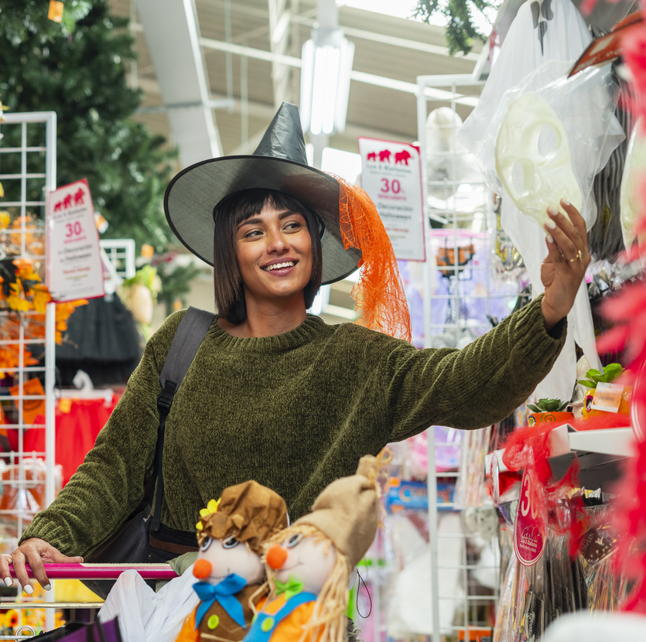
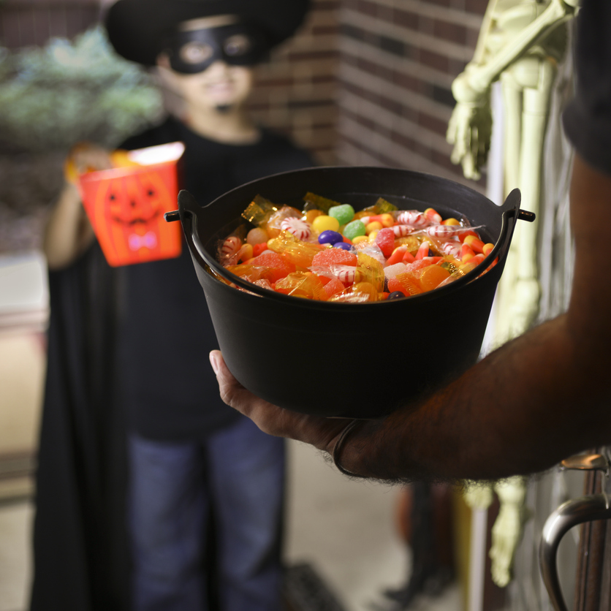
The When & Where: Creepin' Into September
Capturing high-intent shoppers before the start of fall.
The Early Surge:
Nearly half of consumers (49%) now begin shopping in September or earlier, a slight increase from 47% the year prior.
Why They Shop Early:
Shoppers are looking forward to fall (44%), and they want to avoid last-minute stress or missing out on key items (33%).
Where They Go:
Discount stores are the top destination at 42%, up 37% since 2024, followed by specialty shops (31%) and online retailers (31%).
Top Influencers:
Shoppers find inspiration through online searches (37%), retail browsing (27%), and friends/family (21%).
Source: NRF

Slide 6
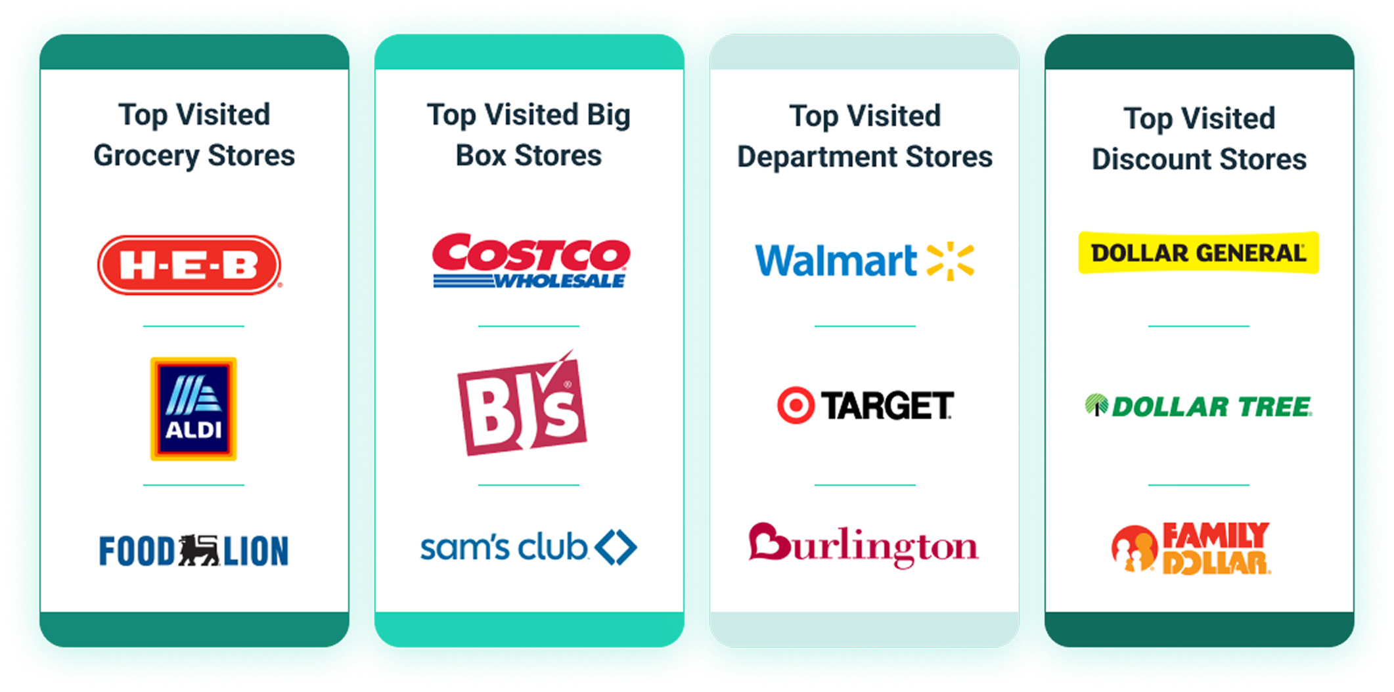
Most Visited Locations for Halloween Shopping
GroundTruth’s first-party data identified these locations as the most visited stores last year.
Source: GroundTruth Visitation Data

Slide 7
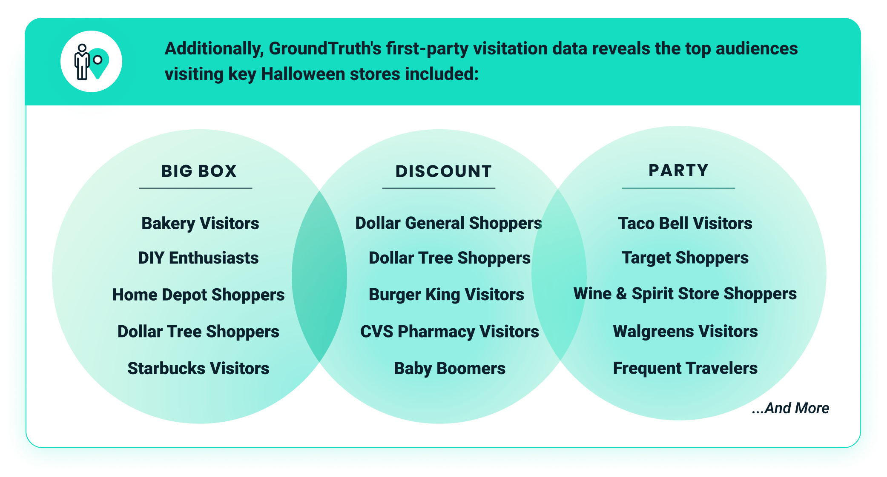
Halloween’s Biggest Fans: GroundTruth Audiences
The takeaway:
The Halloween market is driven by audiences who begin their journey early and prioritize retail value. To win in this high-spend environment, brands must bridge the gap between digital inspiration and GroundTruth real-world visitation data.
Through Behavioral Audience Targeting, GroundTruth maps physical activity to create proprietary segments like Deal Hunters and DIY Enthusiasts. Activating these audiences ensures your brand reaches the right people at the right time to drive measurable business results this Halloween season.
Source: GroundTruth Visitation Data

Slide 8






The Frightfully Effective Approach to Halloween
Leverage GroundTruth’s location-based data to engage a dedicated and captivated audience this season.
Behavioral Audiences
Connect with the enthusiasts driving the $13.1B market, based on a mix of behavioral attributes & demographics including Gen Z, Millennials, Parents, and "Early Fall" Decorators.
Location Audiences
Target shoppers based on visits to top destinations like Discount Stores, Specialty Costume Shops, and Big Box Retailers.
Custom Audiences
Layer visitation data with purchase intent and first-party data to reach price-conscious shoppers looking for the best seasonal deals.
Proximity Targeting
Geofence competitor locations or event venues (like haunted houses and pumpkin patches) to connect with audiences nearby.
Retail Block Targeting
Reach shoppers in real-time within shopping center boundaries to influence their final purchase decisions.
Neighborhoods
Zero-in on households with a high affinity for Halloween decor and candy brands to drive local store visits and household penetration.

Slide 9



How Halloween Weather May Play Tricks on Retailers
The takeaway:
Consumers have their costumes ready and their routes mapped but the ultimate wild card remains weather. For retailers, weather volatility is a major driver of what, when, and how shoppers spend their $114 budget. By aligning your strategy with the forecast, you turn a potential trick into a significant ROAS-driven retail treat.
GroundTruth’s Weather Triggering converts real-time conditions into actionable ROI. By deploying location-specific messaging for indoor party supplies during a "Wicked Washout" or cooling treats during heatwaves, we ensure your brand is always the relevant solution. This precision eliminates wasted spend by meeting shoppers exactly where their mindset and the environment intersect.
Hauntingly Hot
Warm weather can encourage people to consume cold drinks, serve candy that does not melt, and shift activities to later in the evening.
A Wicked Washout
Rainfall could spike demand in categories such as umbrellas, or raincoats to stay dry while trick-or-treating.
Bone-chilling Cold
When conditions are uncomfortably cold, trick-or-treaters may opt for heavyweight costumes or bundle up with gloves, coats and boots.

Slide 10

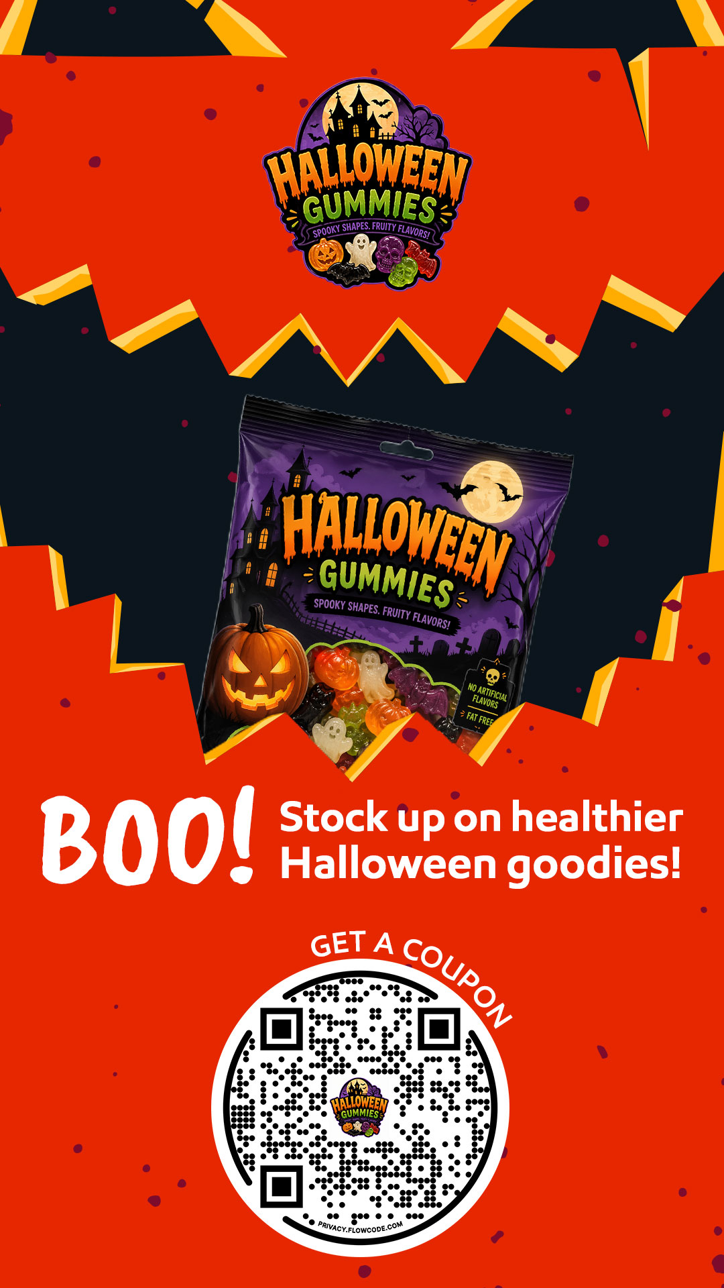

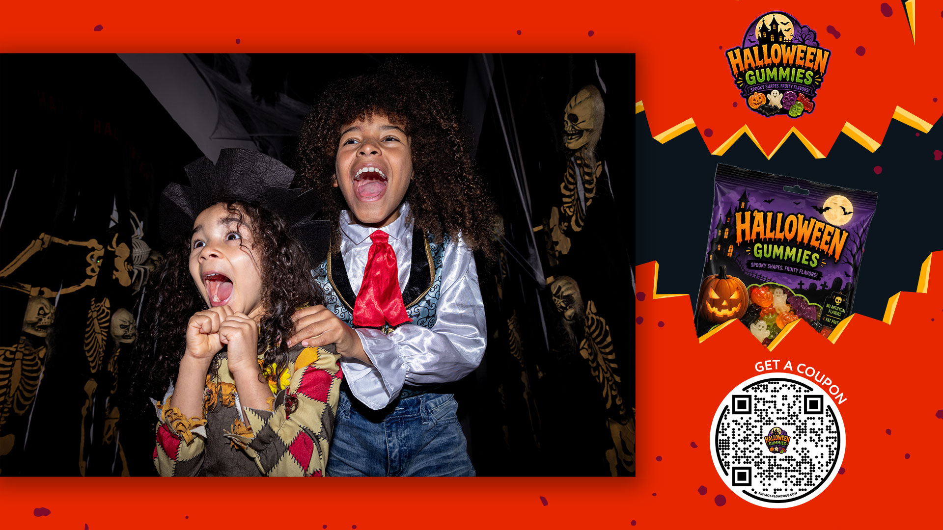



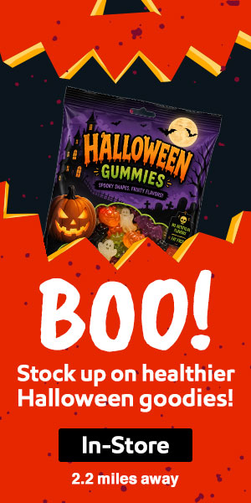
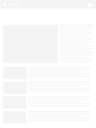





Cross Platform Media Solutions
Reach Halloween shoppers with the right messaging on multiple screens throughout their buyer journey.
Channel & Creative Insights:
60% of shoppers say they engage most with ads featuring spooky or playful themes.¹
Convert passive viewers into active shoppers using CTV features like QR codes to drive immediate action from their couch.
Build powerful repetition by extending CTV messaging across DOOH, Social, and Audio for a seamless omnichannel journey.
Source: ¹The Marketing Cloud

Slide 11






How a Premium Chocolate Brand Increased Sales and Household Penetration with an Omnichannel GroundTruth Campaign
Precise targeting tactics across Mobile and CTV screens led to real business results.
Strategies:
Omnichannel Approach: Combined CTV and Mobile media, reaching consumers on the screens they choose to consume content on.
Purchase-Based Targeting: Included Competitor Brand Purchasers to conquest the competition.
Location Targeting: Reached Retailer Loyalists to focus on audience loyalty and real-time, in-store engagement.
Key Takeaways: The combination of targeting tactics across Mobile and CTV screens allowed the brand to reach their target audience and drive real business results, including increased sales at Walmart locations, household penetration, and ROAS. In addition, CTV media accounted for a 14.5% sales lift, while Mobile media accounted for a 7.7% lift.
7.6X
6.1%
1.4X
4.4%
Return on Ad Spend with CTV Media
Increase in Household Penetration with
CTV Media
Incremental Return on Ad Spend on Mobile
Increase in Purchase Occasions Driven by Mobile Media

